Slide 1
RTA-SWaT project

Slide 2
Task Distribution
Mohamed Aharrat
Environment setup with Docker
Kafka Integration
Spark Integration (PySpark)
InfluxDB Storage
Grafana Integration
Chronograf Integration
Spark processing logic
Pipeline 1 (One class SVM)
Grafana Dashboard for Pipeline 1
Sarvarjna Lakshmi Narayana
Initial Kafka producer setup
Pipeline 3 (K Means) and 5 (LOF)
Grafana Dashboard for Pipeline 3
Monitoring metrics setup
Metric Collection using Telegraf
Metrics Monitoring Dashboard using Chronograf
Initial Influxdb integration

Slide 3
Task Distribution
Samir Aliyev
Data Preprocessing ( PCA and Standatzation
Pipeline 2 (Isolation Forest)
Pipeline 2( Logistic regression
Influx-Grafana connection for Pipeline2
Grafana Dashboard for pipeline 2
Report contribution
Khasay Mirzali
Pipeline 4 (DB Scan)
Initial data exploration analysis
Influx Grafana connection for pipeline 4

Slide 4
Summary
1) Dataset information
2) Data pre-processing
3) Process design schema
4) Open Source tools for our project
5)Algorithm selection
6) Data visualisation

Slide 5
Dataset information
The dataset consists of 13661 samples with 51 attributes which were collected for 6 continuous days. All the data was logged continuously once every second for 136 hours into a Historian server.
Data recorded in the Historian was obtained from the sensors and actuators of the testbed.

Slide 6
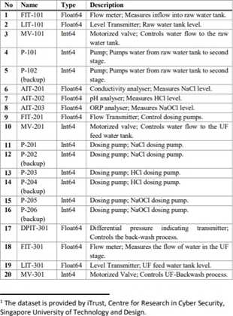
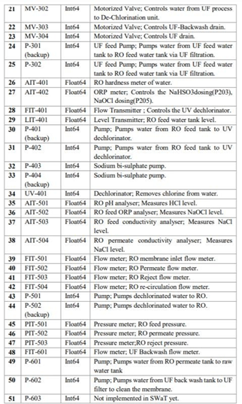
Description of attributes

Slide 7
Data pre-processing
In this process, we dropped 12 columns which consists of one value. So, these atributes does not have effect on final outcome.
The attributes namely :
AIT401, P102, P202, P204, P206, P302, P402, P403, P404, P502, P601, P603

Slide 8
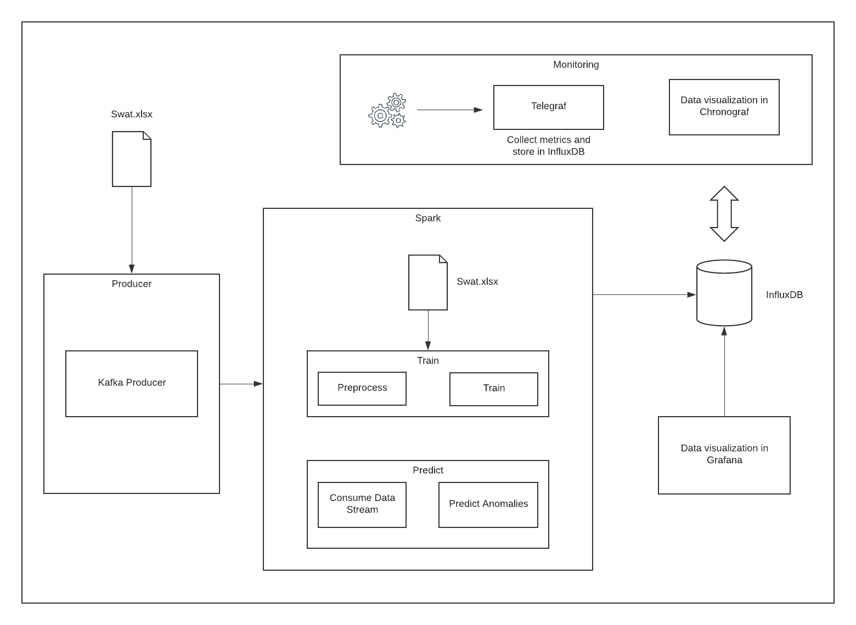
Process design schema

Slide 9
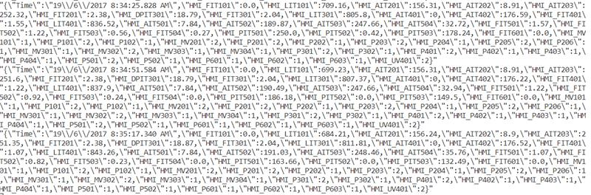
Data published by Kafka

Slide 10



Open Source tools
The frameworks we are about to use are :
Kafka, Spark, Influx DB, and docker to communicate.
Kafka provides guaranteed message delivery with proper ordering.
As the stream data comes continuously and is voluminous, we require a scalable distributed framework. We can use Apache Spark which is fault-tolerant and supports distributed real-time computation systems for processing fast, large streams of data.

Slide 11
Algorithm selection
In this part, we apply 4 algothims which are the used for anomaly detection.
There are: Isolation Forest, K-means, One-class SVM and DBSCAN
After unsupervised algorithm implementation part, we apply classification. This process and hyper-tuning is done in Python.

Slide 12
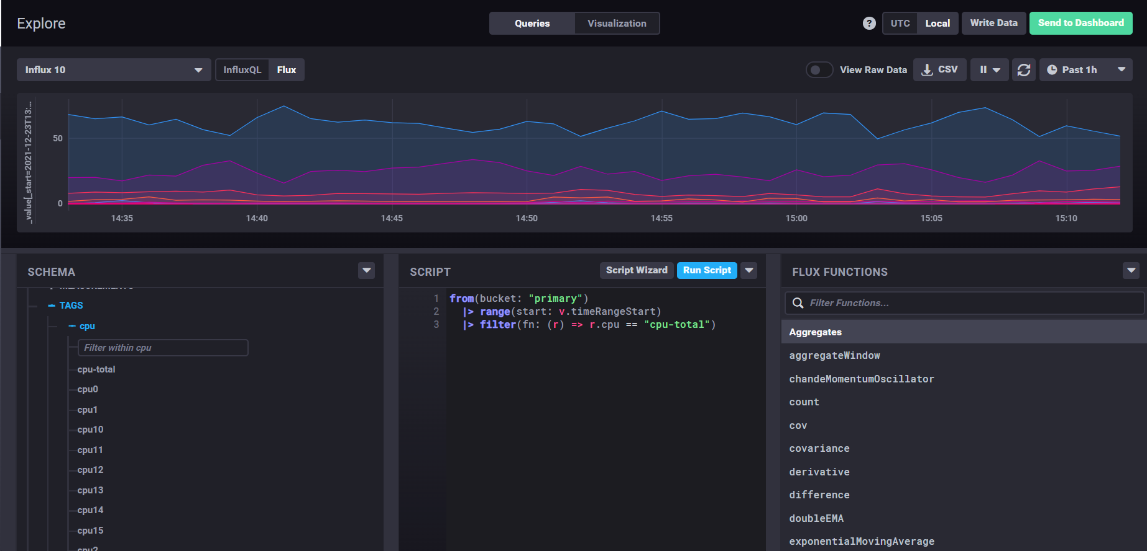
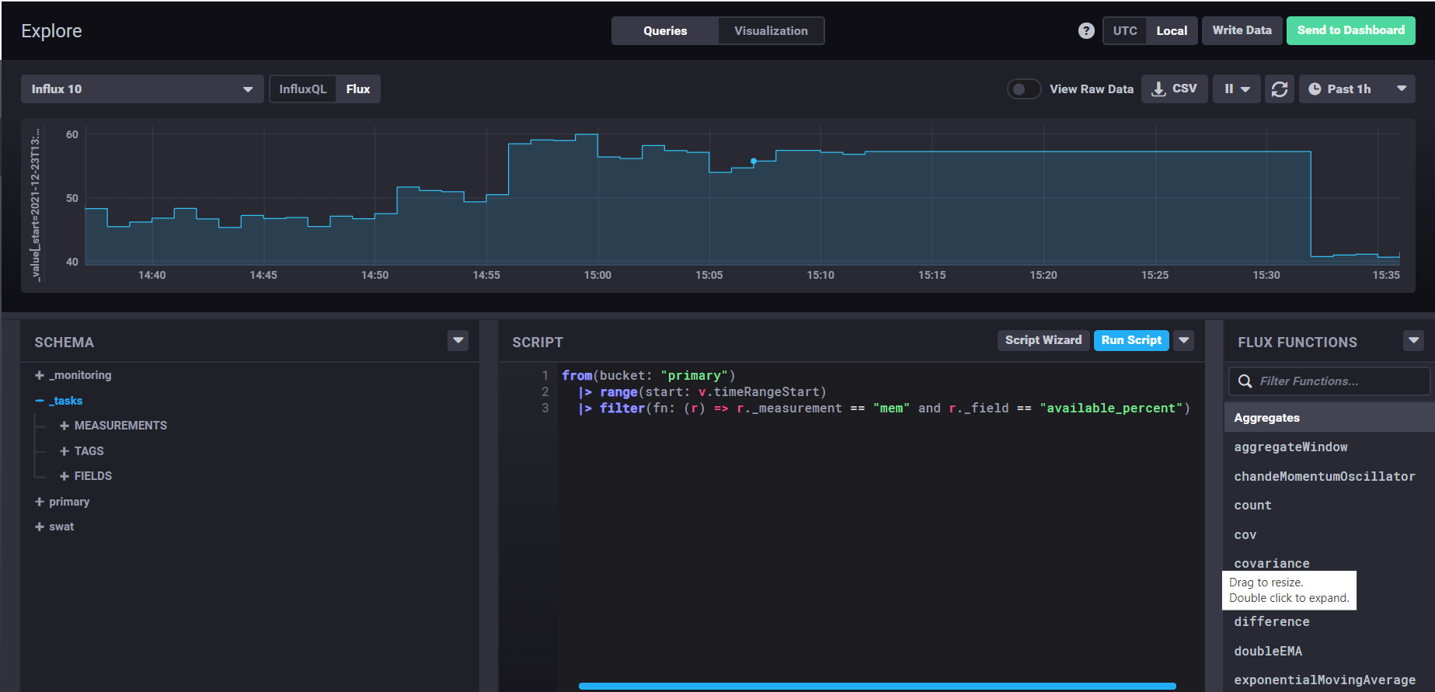
Data visualization

Slide 13
Data visualization

Slide 14
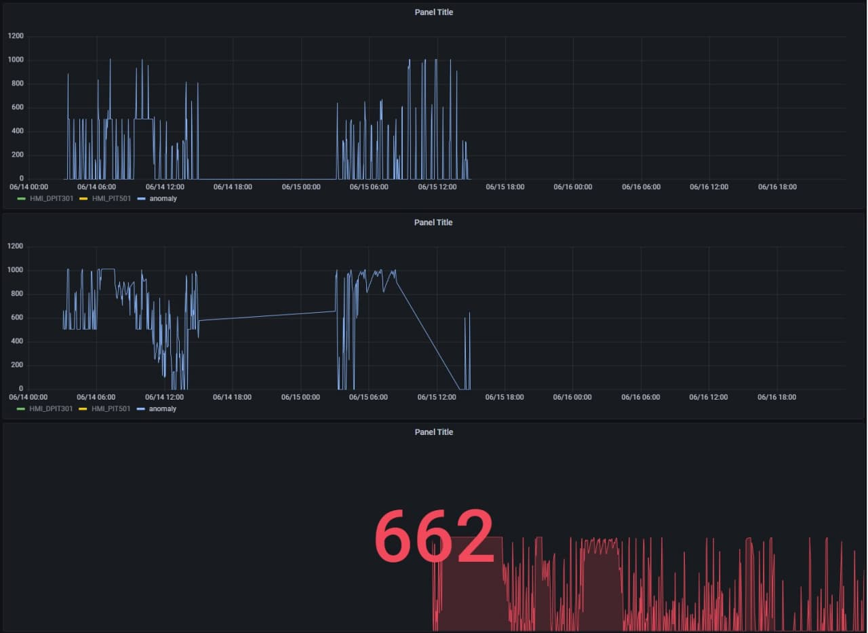
Data visualization

Slide 15
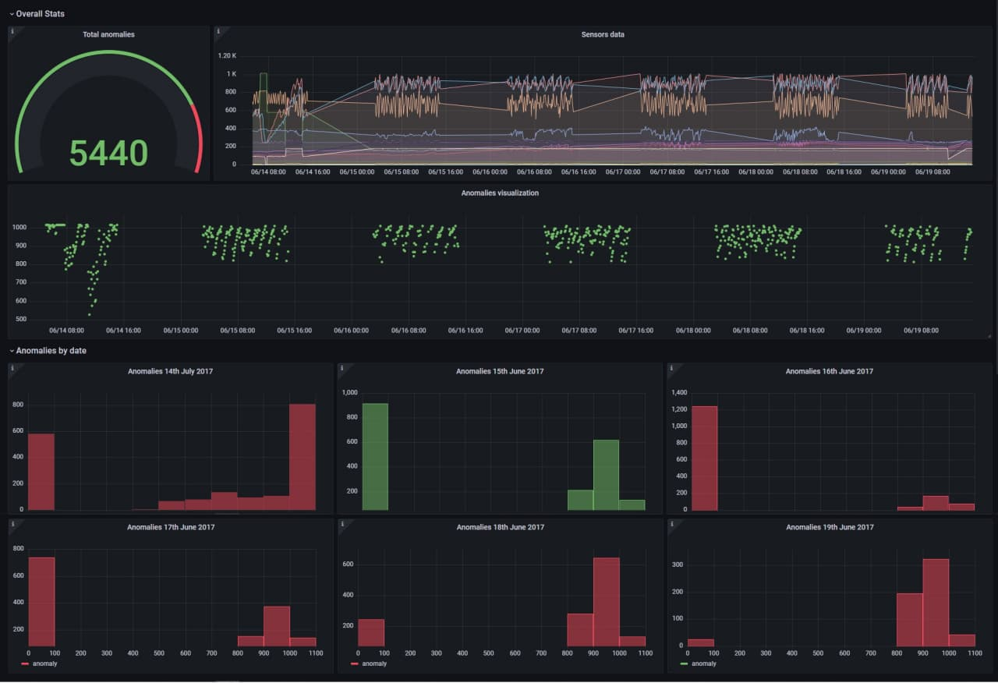
Data visualization

Slide 16
Thanks for your attention.
Any question?

